Slide 1
Multimedia Misogyny Detection By Using Coherent Visual and Language Features from CLIP Model and Data-centric AI Principle
CSE431
Name: M.A.Ahad Shikder
ID: 20301316
Section: 02
Team: 18

Slide 2
Introduction
Promote awareness about the impact of misogynistic content and educate individuals about the importance of respectful and inclusive communication online.
Online platforms should implement robust community moderation systems to monitor and flag misogynistic content, including misogynistic MEMEs.
Develop and refine automated systems and algorithms to identify misogynistic MEMEs. This can involve utilizing machine learning and natural language processing techniques to analyze visual and textual elements of MEMEs and flag those that contain misogynistic content.

Slide 3
Related Works
The Automatic Misogyny Identification (AMI) task has gained traction in the field of natural language processing (NLP), with research focusing on identifying and categorizing misogynistic content in online communication, particularly in tweets.
Various research competitions, such as IberEval-2018 and Evalita-2020, have been organized to advance AMI research, involving teams from different countries and languages, including Spanish, English, and Italian.
Different approaches have been explored, ranging from traditional machine learning algorithms like SVM and logistic regression to more advanced techniques like convolutional neural networks (CNN) and fine-tuning pre-trained models such as BERT and Roberta.
The organization and labeling of misogyny-related data is an important research consideration, with efforts made to create high-quality datasets with hierarchical taxonomies and meticulous annotation training, such as the dataset created by Guest et al. (2021) for Reddit posts and comments.

Slide 4
Tasks And Data
The MAMI challenge consists of two sub-tasks: task A is a binary classification task to identify whether a MEME is misogynous or not, while task B is a multi-label classification task to identify non-misogynous MEMEs and four misogyny sub-types: shaming, stereotype, objectification, and violence.
In task A, the goal is to predict the misogyny label, with half of the MEMEs in the training data labeled as misogynous and the other half as non-misogynous..
For task A, the evaluation metric is macro-F1, which measures the overall performance of the model across both misogynous and non-misogynous labels.
For task B, the evaluation metric is micro-F1, which considers the performance of the model on each of the five sub-types of misogyny, including non-misogynous MEMEs.

Slide 5
Methods
Pre-trained Transformer models, such as BERT, Universal Sentence Encoding (USE), and SBERT, were used to extract features from the text part of MEME posts. Fine-tuning BERT updated the model weights, while USE and SBERT kept the pre-trained models intact.
For the visual encoder, the ViT model, a Transformer model applied directly on image patches, was chosen to process MEME images and extract visual representations.
The CLIP model, a powerful vision-language joint model, was used to pre-train visual and language features in a unified embedding space. These features were then combined and fed into a logistic regression (LR) model for predicting misogyny.
Early fusion, where visual and language features were concatenated, was found to be as effective as more advanced multimodal fusion methods.

Slide 6
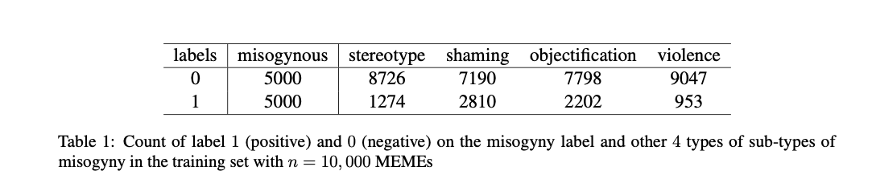
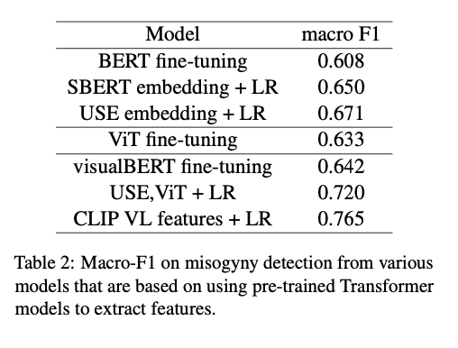
Methods
Table 1:
Provides the count of positive (1) and negative (0) labels for misogyny and its sub-types in the training set.
Shows that the distribution of labels varies among the sub-types, with stereotype being the most frequent and violence being the least frequent.
Table 2:
Summarizes the macro-F1 scores achieved by different models for misogyny detection.
Demonstrates the performance variation of the models based on pre-trained Transformer models, with scores ranging from 0.608 to 0.765.

Slide 7
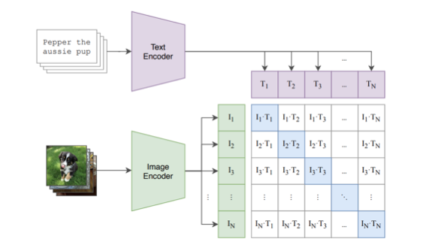
Results
Different models based on pre-trained Transformers were experimented with for misogyny detection, including BERT fine-tuning, sentence-level representations (SBERT and USE), ViT fine-tuning, visualBERT fine-tuning, early fusion of USE and ViT embeddings, and CLIP VL features.
The performance varied across these models, with the CLIP model achieving the highest macro-F1 score of 0.765 for misogyny detection.
Fine-tuning BERT and using sentence-level representations showed improved performance compared to the BERT fine-tuning alone.
ViT fine-tuning demonstrated the importance of image features in misogyny detection.
Early fusion of USE and ViT embeddings with logistic regression yielded a higher performance than visualBERT fine-tuning.
Utilizing the CLIP model provided unified textual and visual features, leading to a significant improvement in macro-F1 score.
The DeepInsight model, which converts VL features into 2D images and uses a CNN for classification, did not perform as well as other models.
The results highlight the effectiveness of simple models like logistic regression when combined with high-quality multimodal features from CLIP.
Expanding the labeled training data proved to be an effective approach for consistently improving misogyny prediction performance.

Slide 8
Discussions
Multimedia misogyny detection is crucial for combating harmful information and promoting healthy online communication.
The focus of the research is on leveraging pre-trained Transformer models for high-quality multimodal feature extraction.
Simple models like logistic regression (LR) applied on sentence-level representations outperform fine-tuning BERT models or complex joint Visual-Language (VL) models.
The CLIP model, trained on a large text-image dataset, provides high-quality multimodal features suitable for downstream classification tasks.
Effective feature representation is more important than using sophisticated models like DeepInsight.

